Slide 1
Introduction to Game Asset Creation (CIS5014)
By Dylan Workman

Slide 2


Tools Used: Blender and Unity

Slide 3
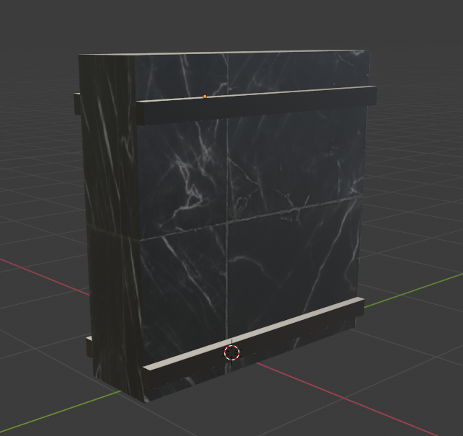
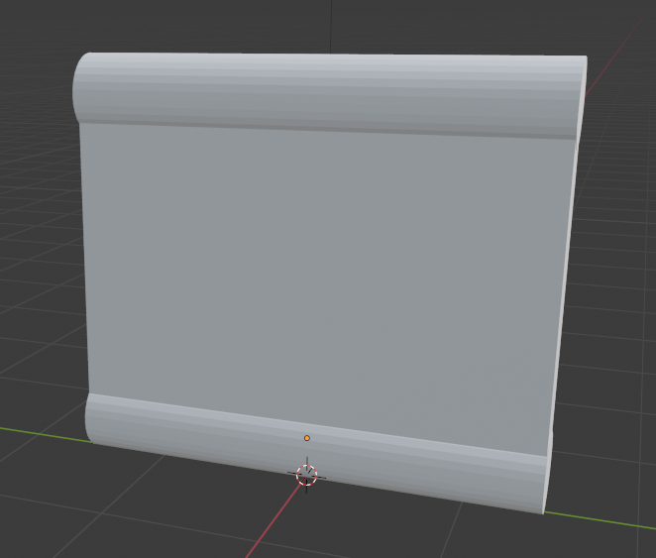
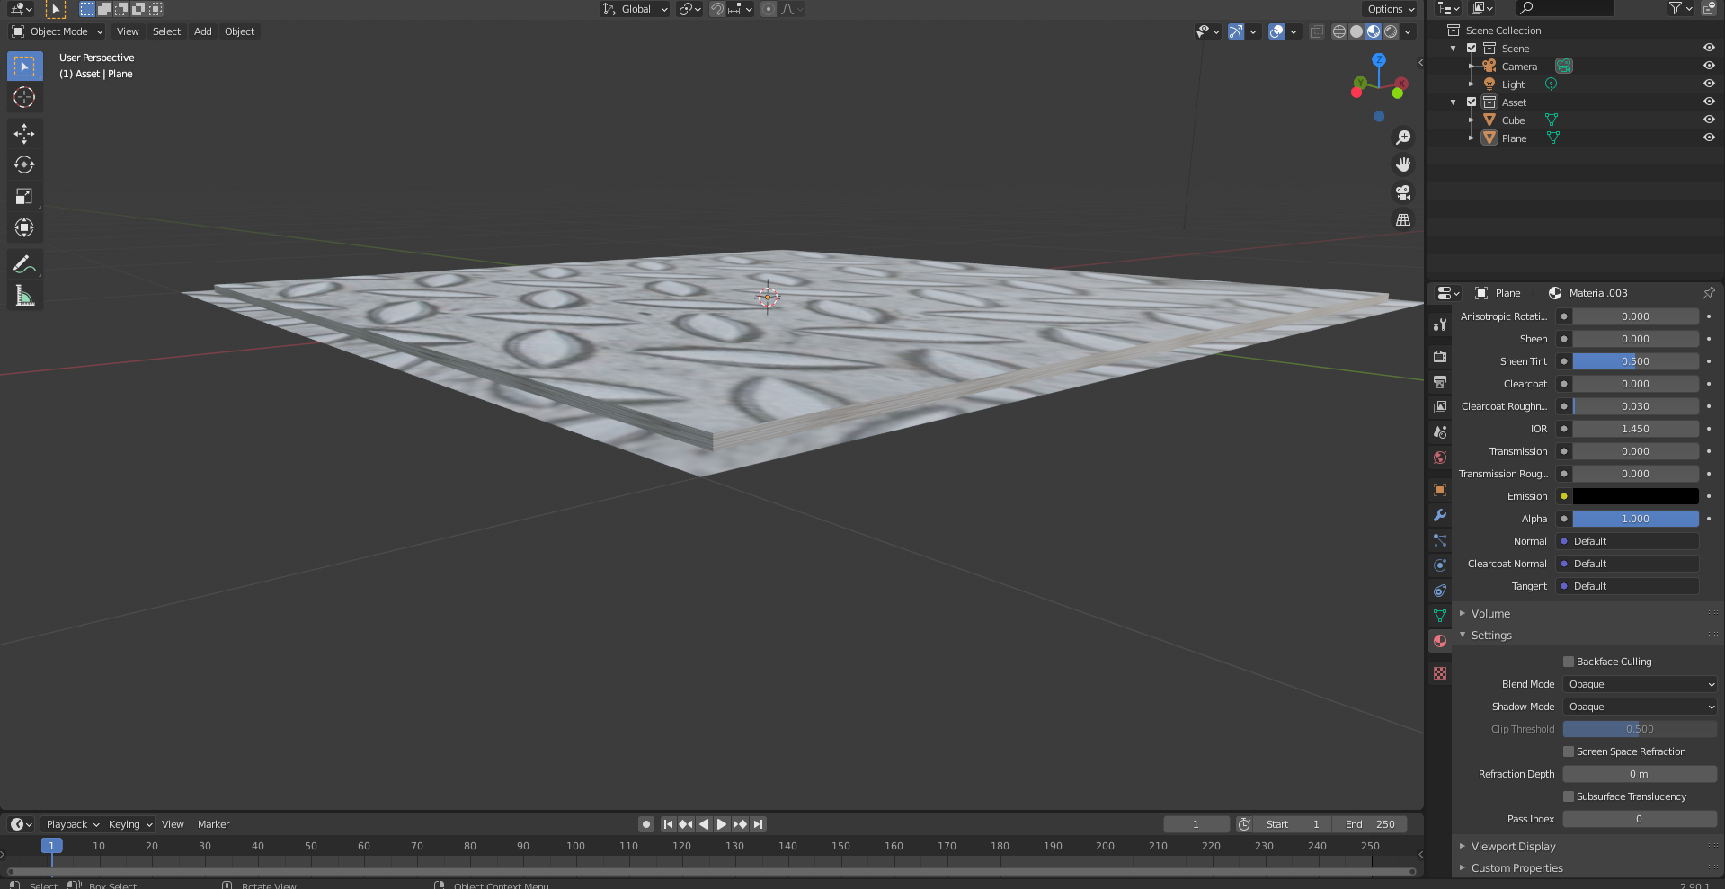
3D Modelling: Scene Objects
Wall Objects
Pickups
Miscellaneous
Blender Shortcuts

Slide 4
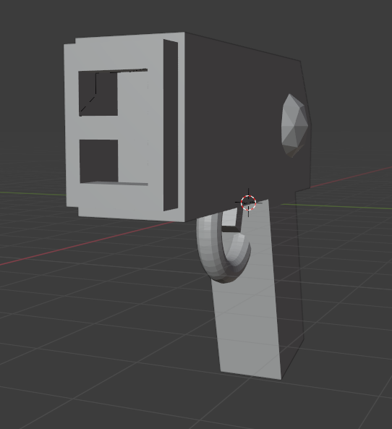
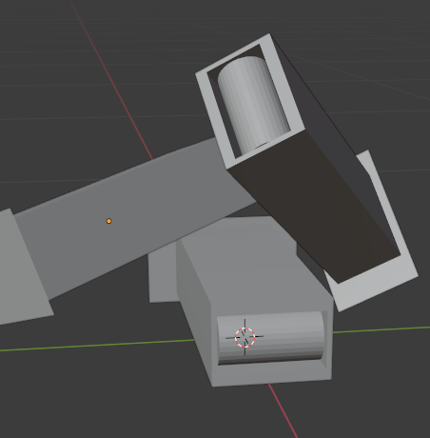
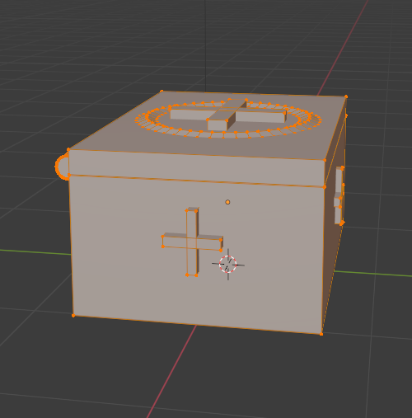
3D Modelling: In-Game Items
Player Weapon
Ammunition Pickup Pile
HP Med Kit

Slide 5
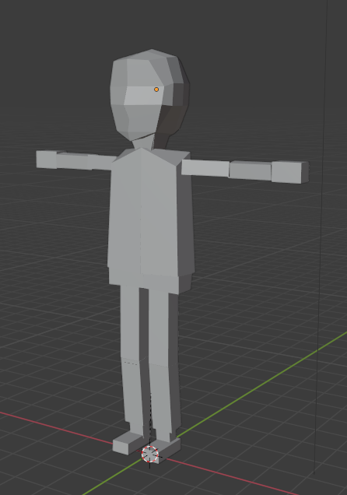
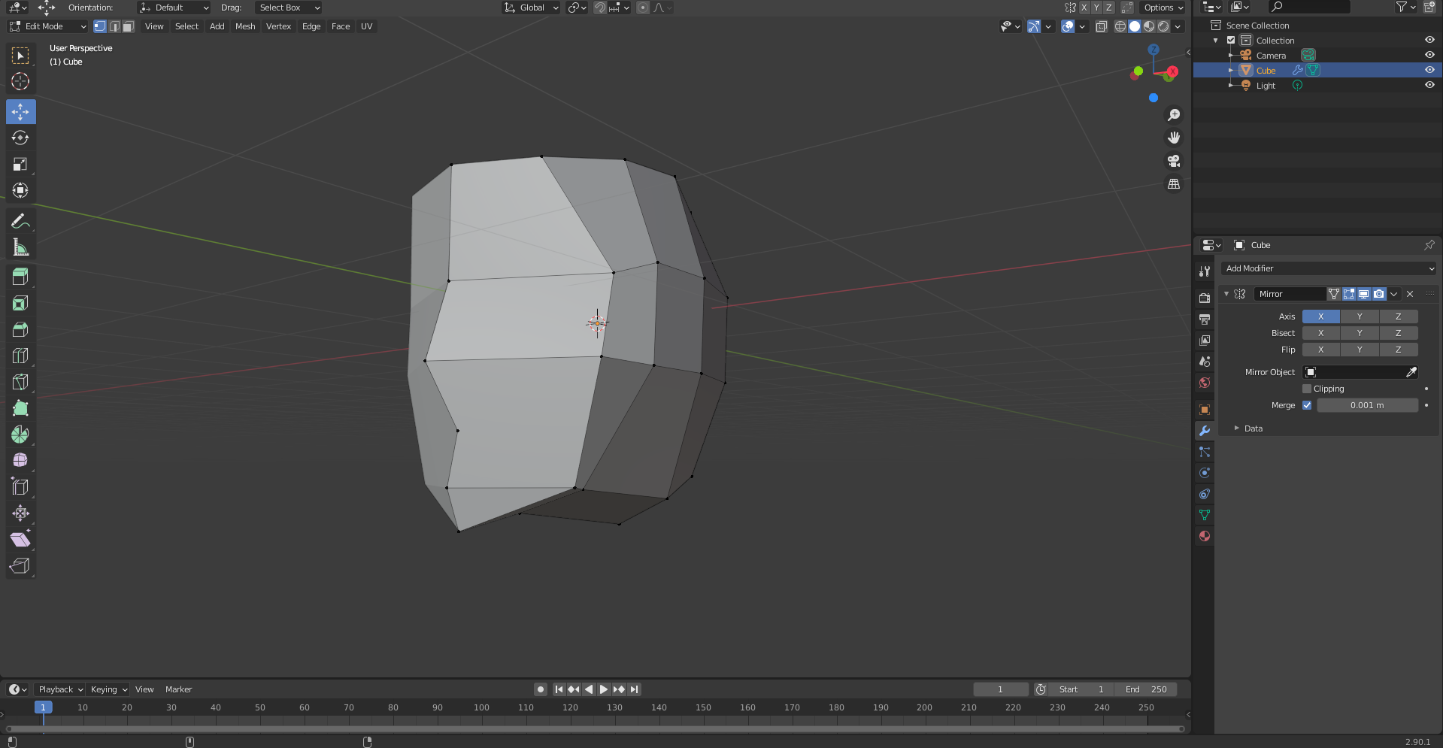
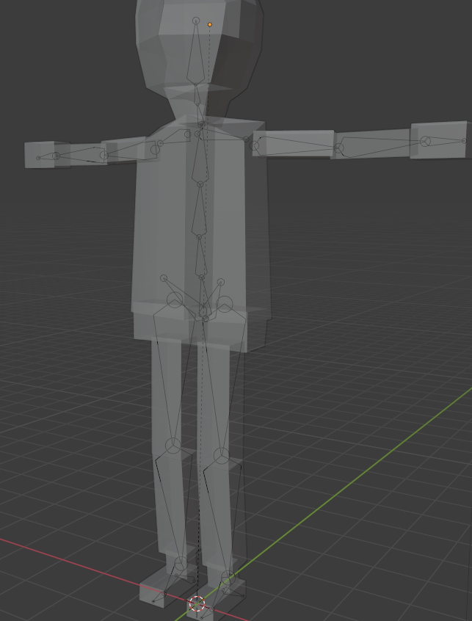
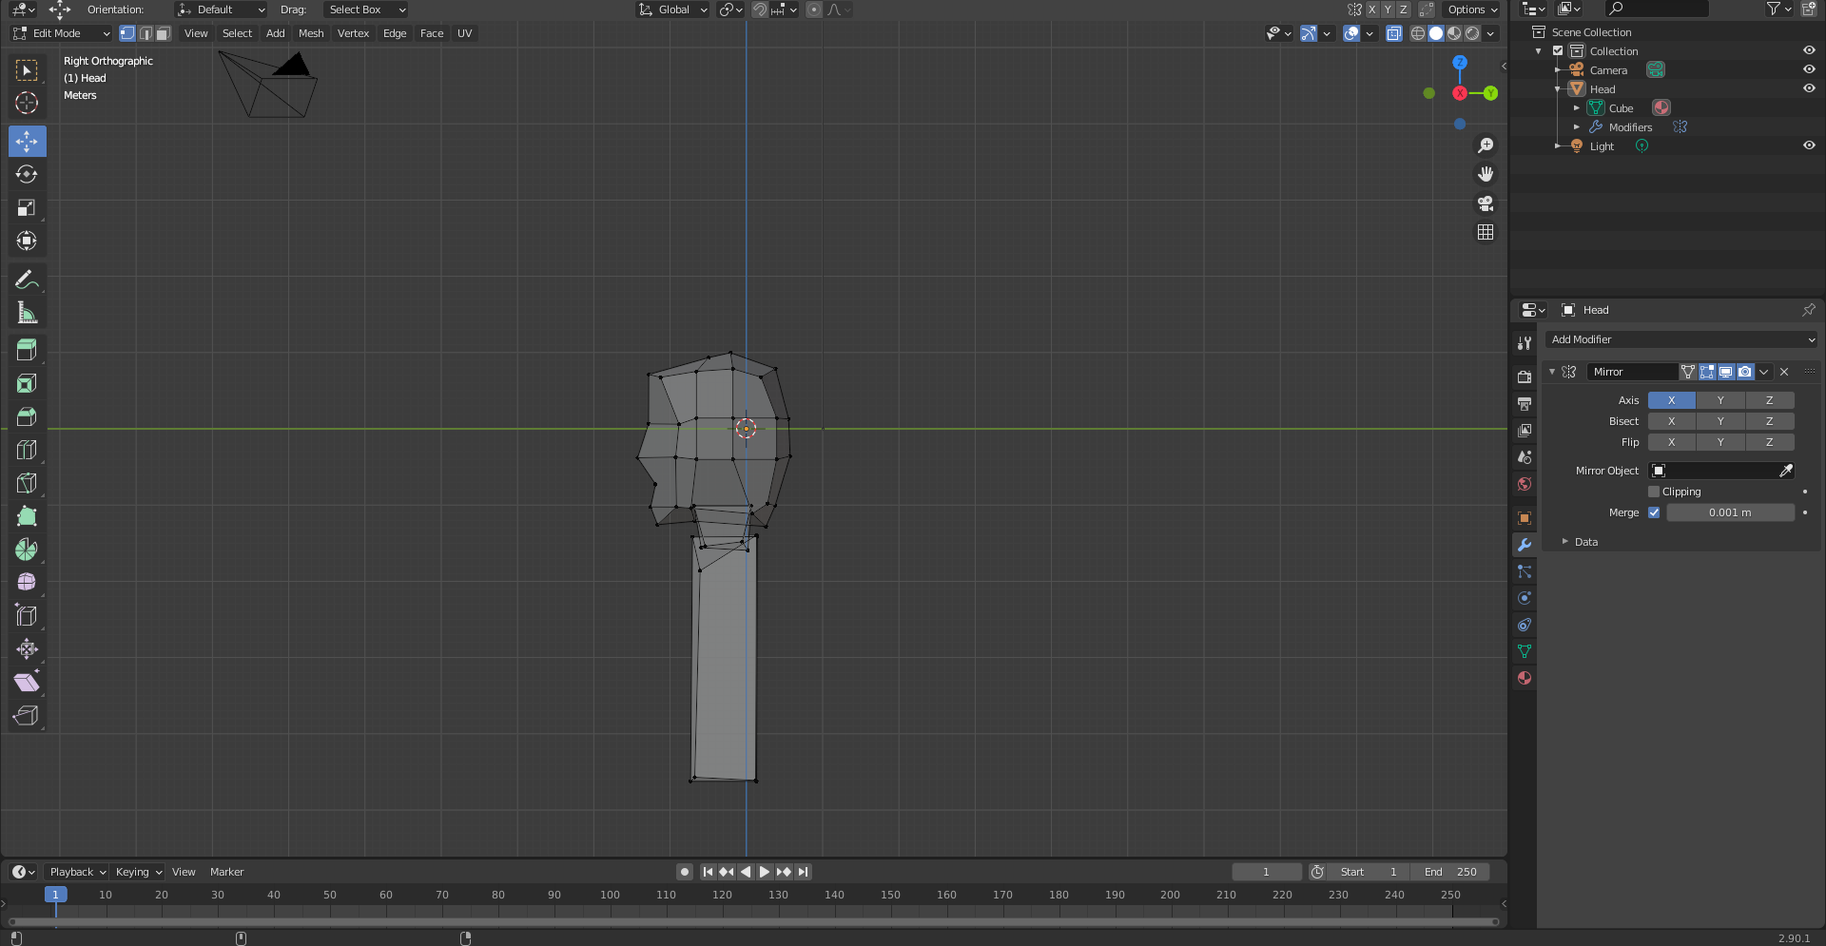
3D Modelling: Character Sprite
Basic Cubic Geometry
Use of Sculpting Tools
Hotkeys for joining objects
Sprite rigged for animating

Slide 6
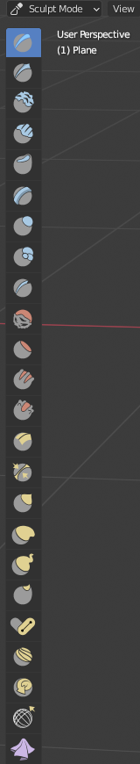
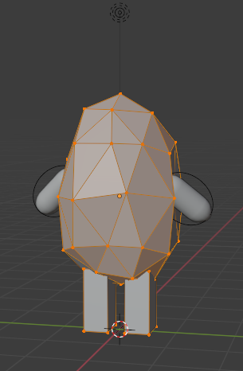
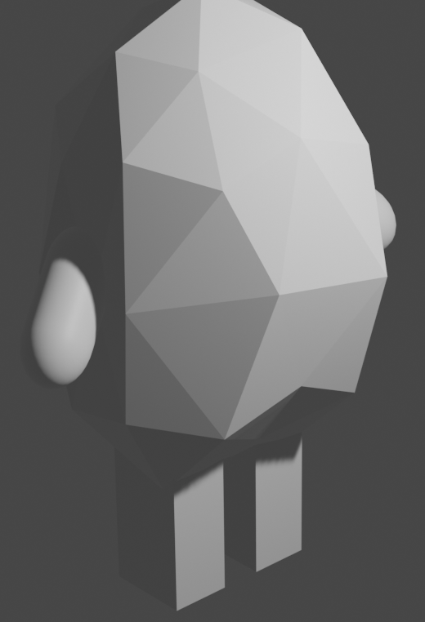
3D Modelling: Enemy Sprite (Basic)
Low Poly
Basic Shapes
Serves as enemy placeholder
Sculpt Tools Used

Slide 7
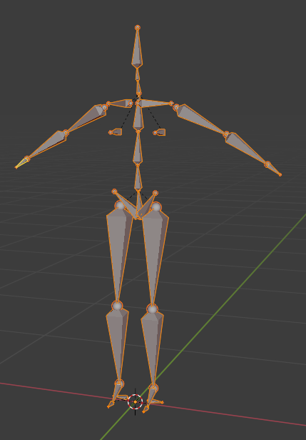
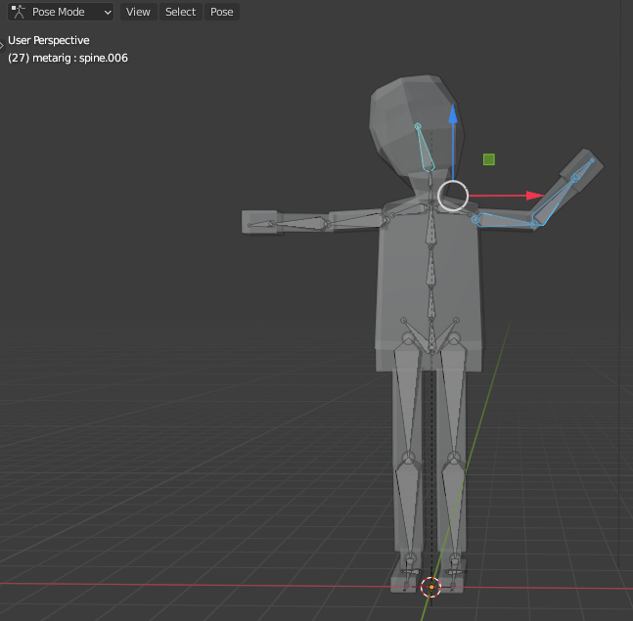
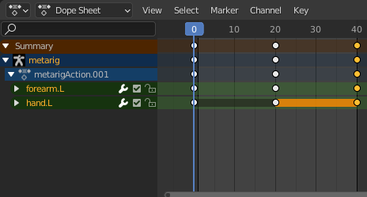
Animation: Character Action Tools
Body Rigging (Skeleton for animation)
Keyframe animations
Movement of character rig objects at different rotations, positions, etc.
Fixed loop for animation

Slide 8
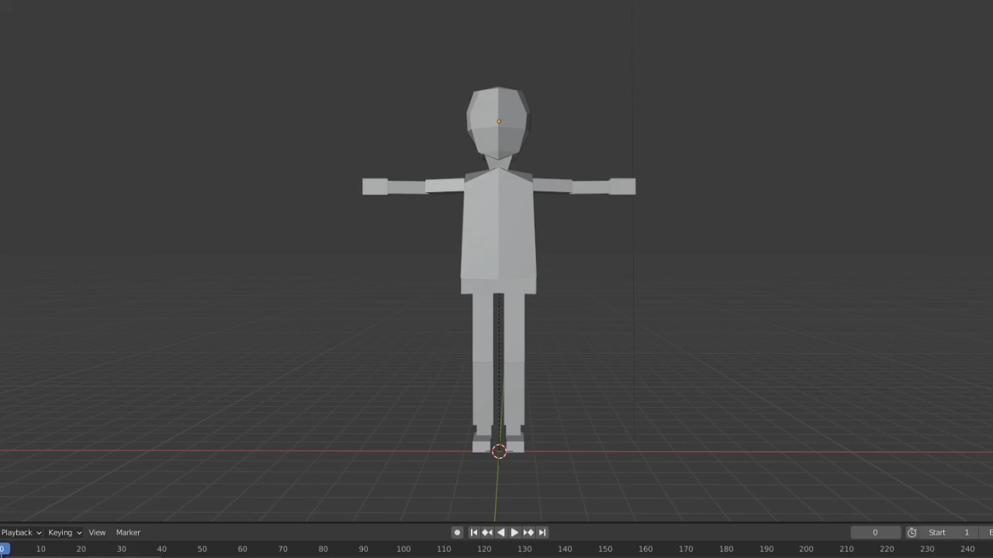
Animation: Character Motions
Simple hand gestures and head movement
Leg bone rigging broken, no walking cycle (problem occurred due to model sculpting)

Slide 9
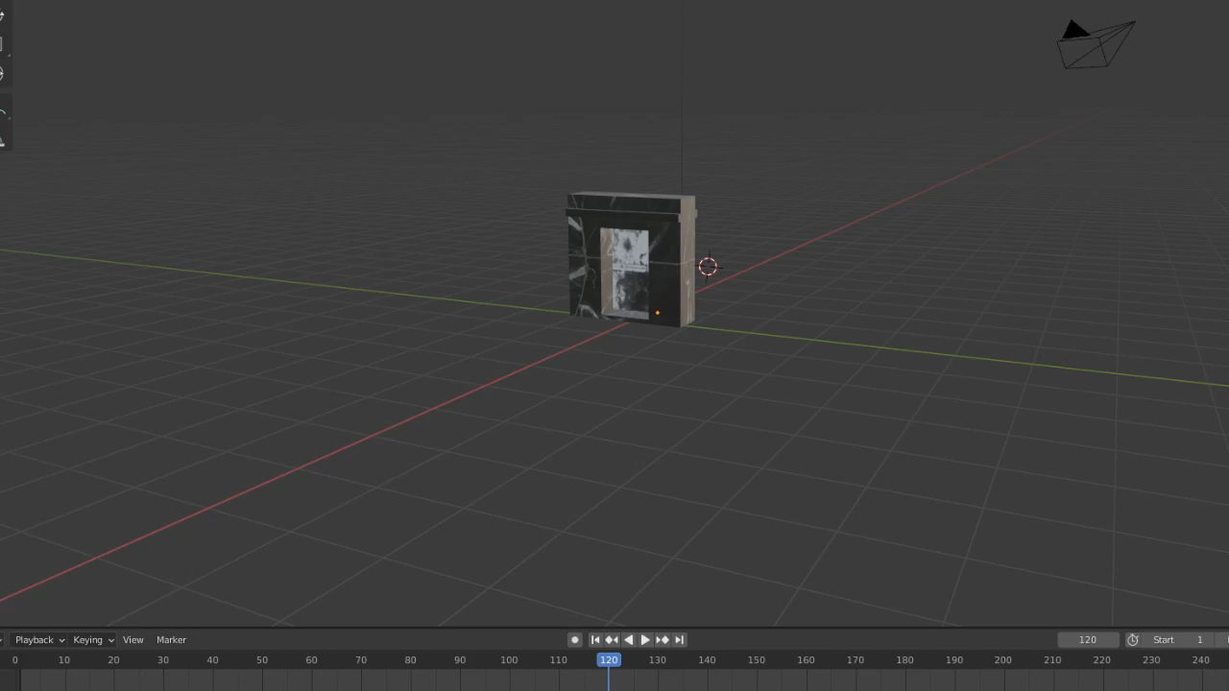
Animation: Other Animations
Door Animation
Use of Keyframes
No body rig like character model
Simple transformation on Z-Axis (90/-90 degrees)

Slide 10
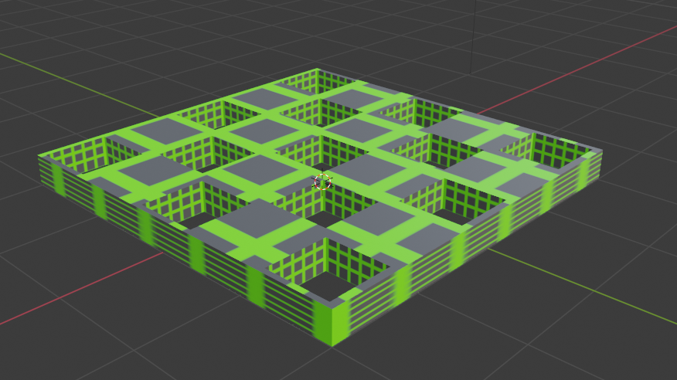
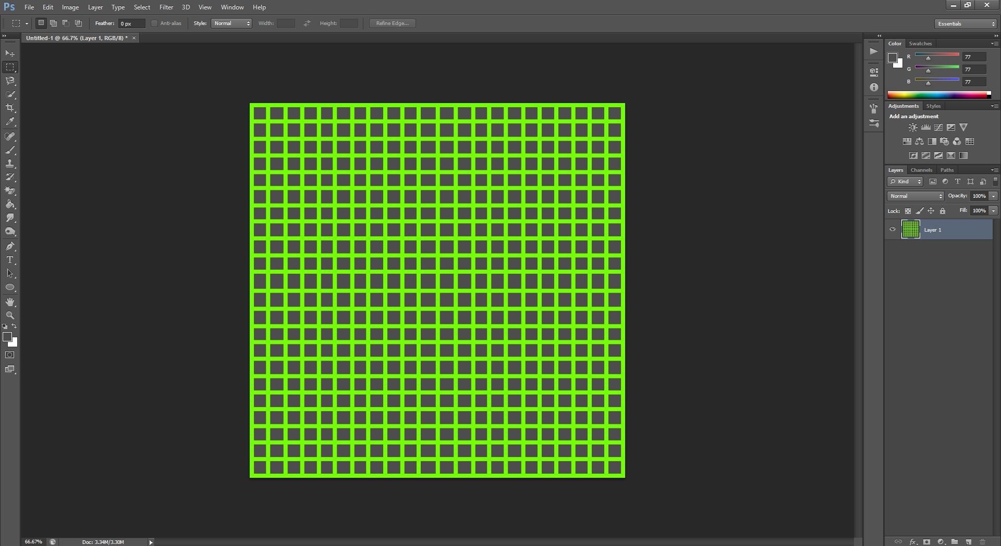
Textures: Creating and Using
Use of dark colours and bright greens to fit with alien-like theme
Simple square shapes to fit style of levels

Slide 11
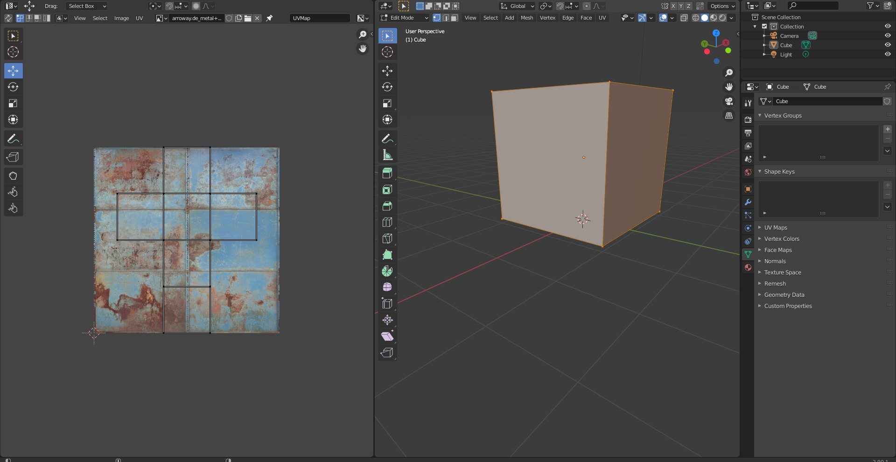
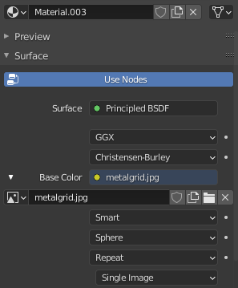
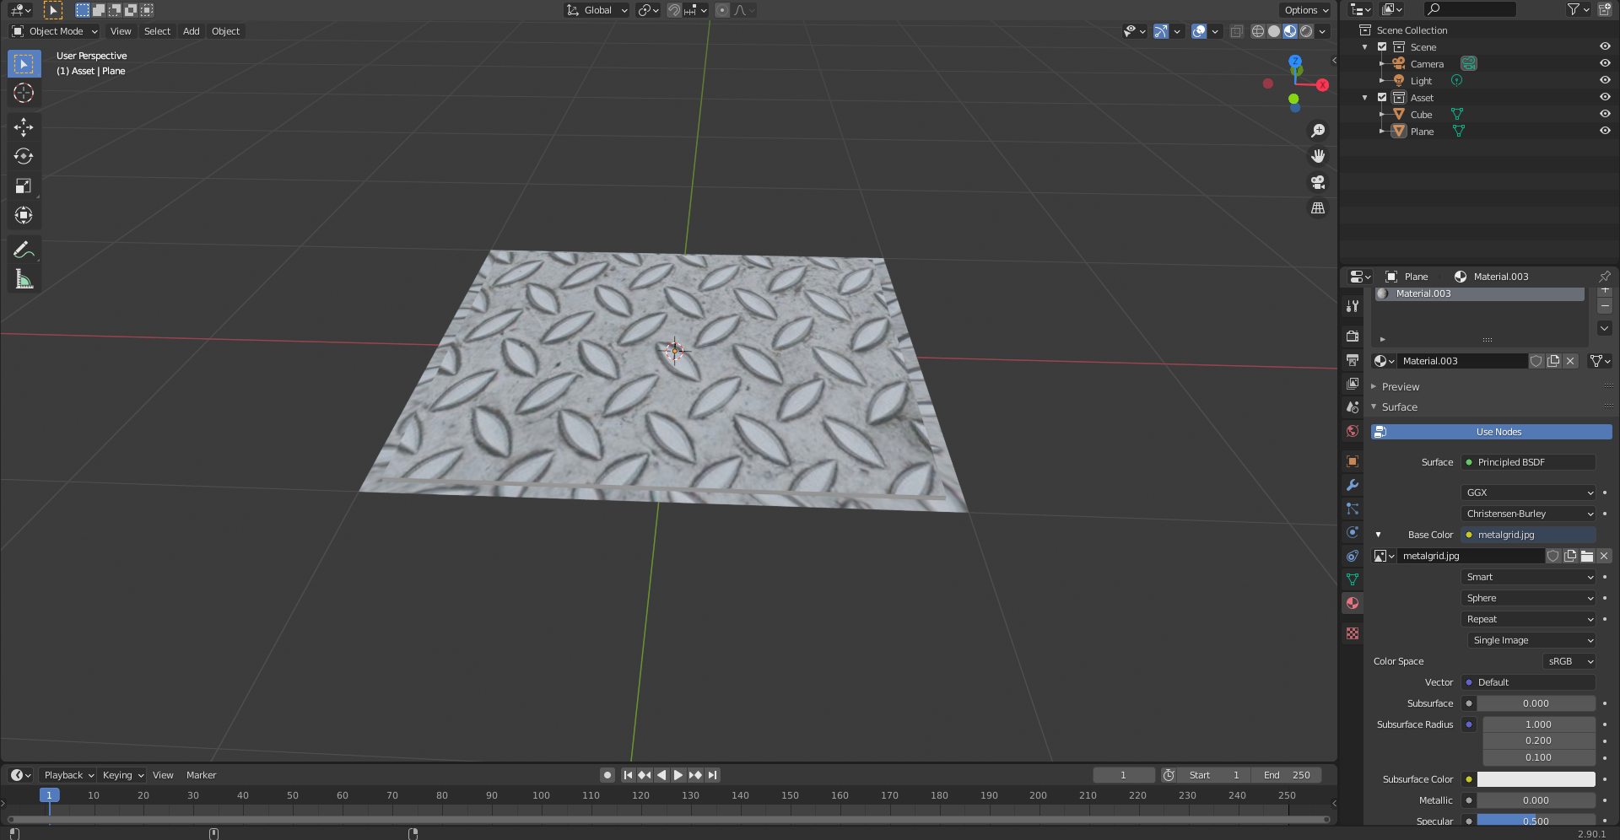
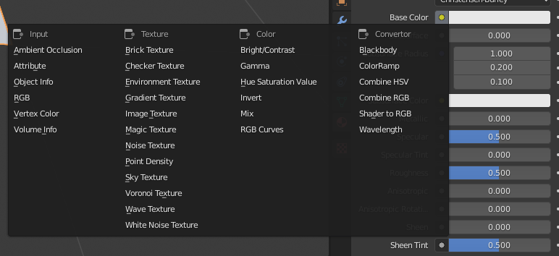
Textures: Wrapping
Useful for simple geometry
Good on walls
Less flexibility
Useful for quick texture mapping
Also includes UV Unwrapping

Slide 12
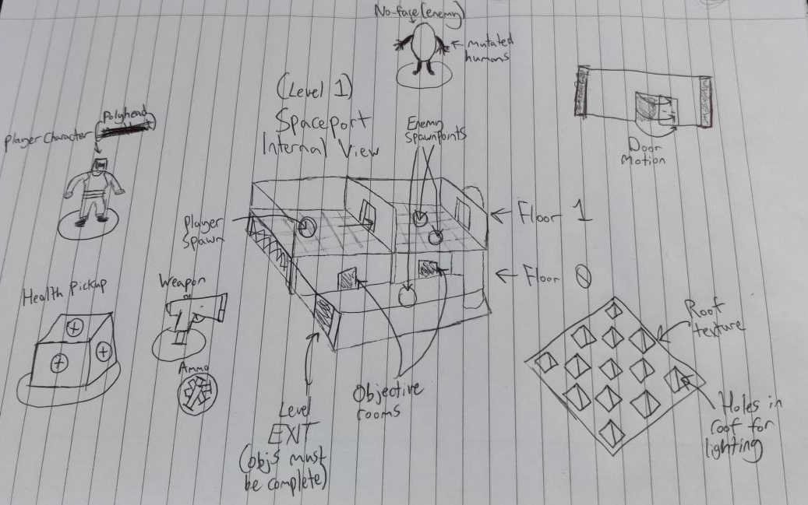
Level Design: Concept Drawings
Rough Sketches
Basic Concept of Levels
Item designs
Level architecture

Slide 13
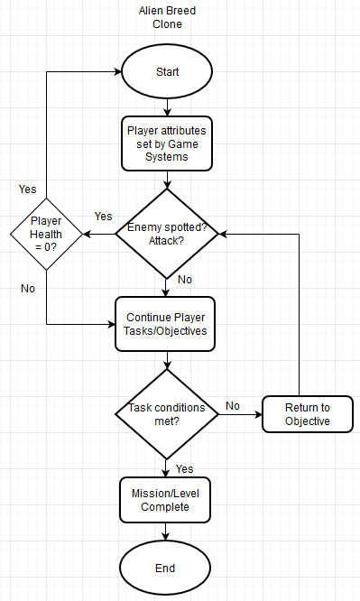
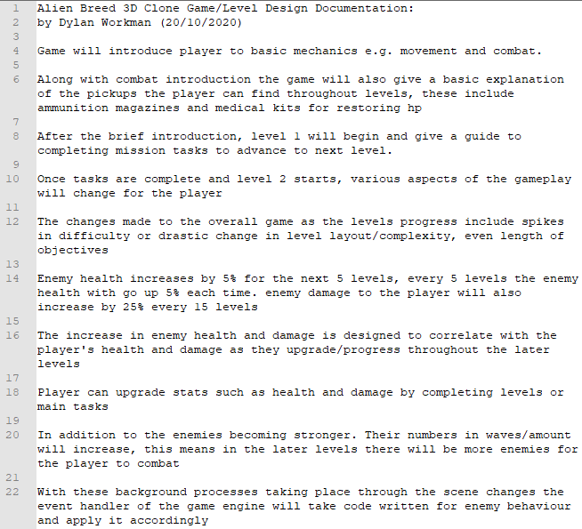
Level Design: Game-loop Flowchart/Systems

Slide 14
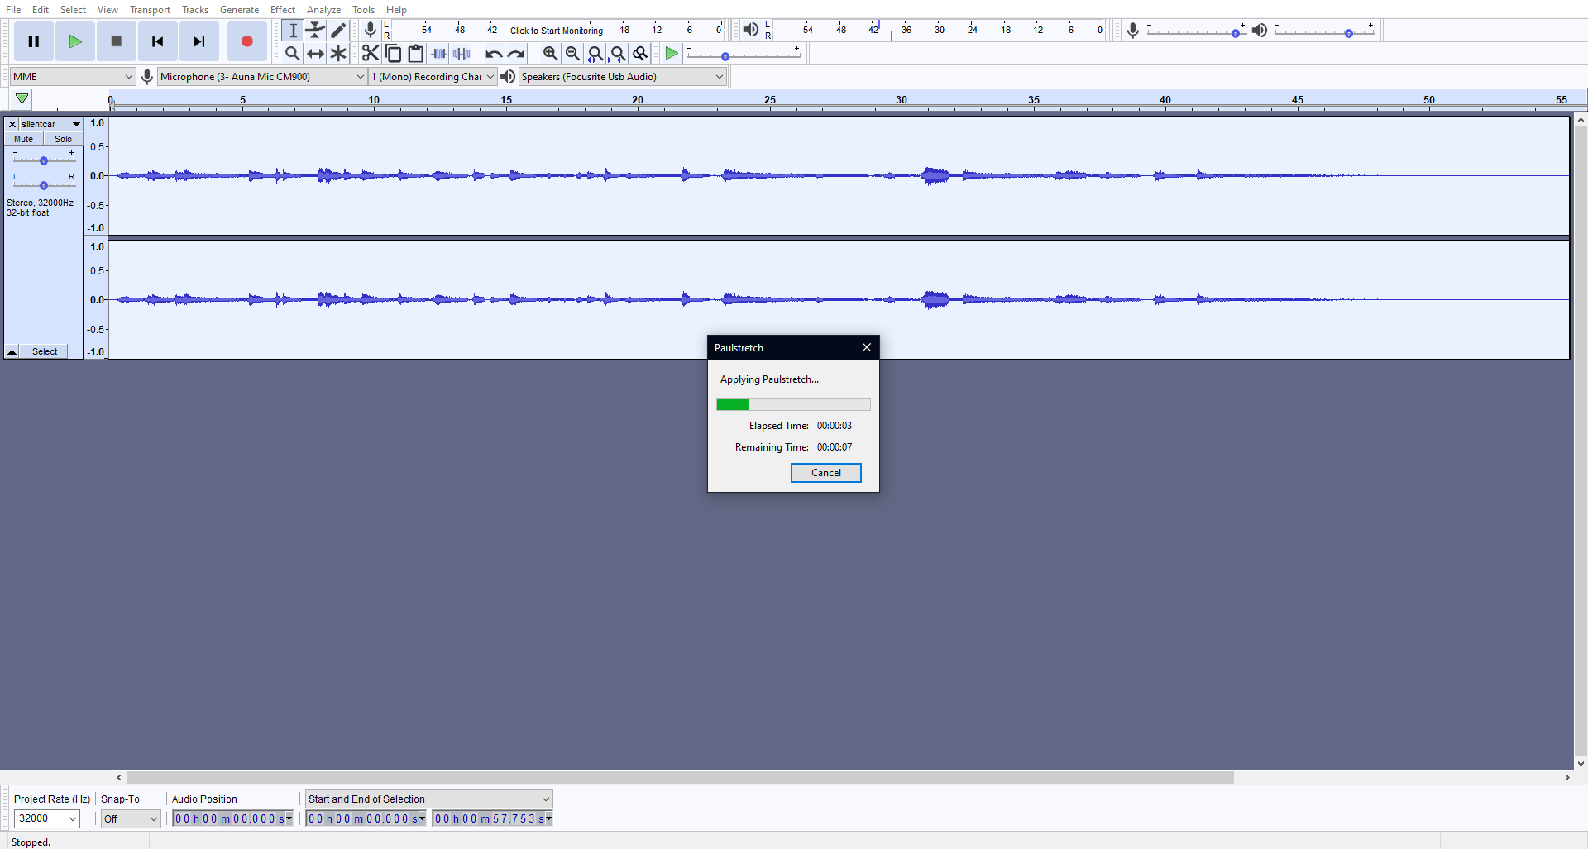
Audio: Game Sounds and Music
Audacity Editing
Use of own guitar recordings
Paulstretch effect to create ambient sounds

Slide 15
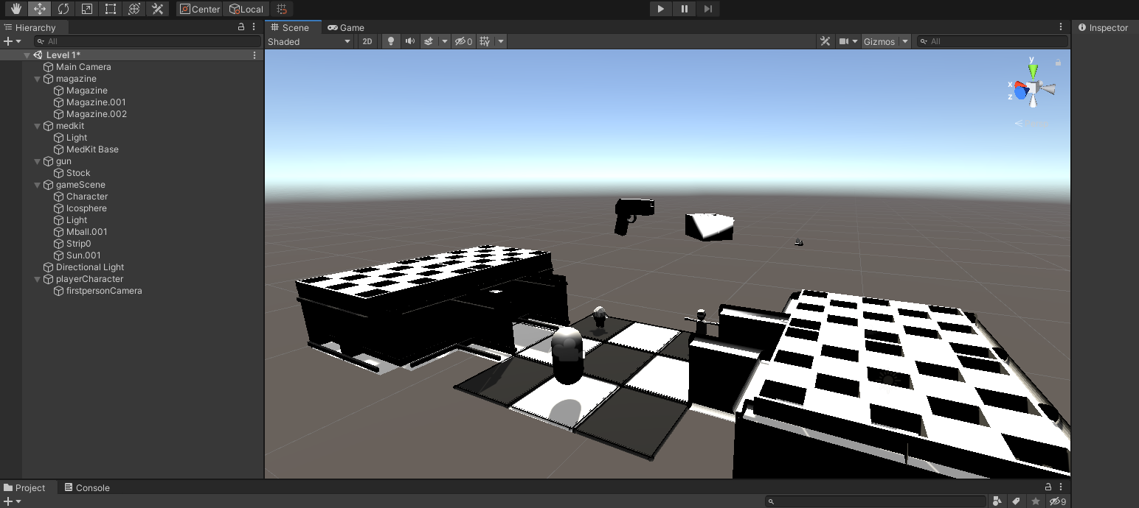
Unity Implementation
Object meshes causing transparency bugs
Shading and lighting out of place
Models load in mostly as intended
Audio implemented correctly
First person camera and controls work as intended

Slide 16
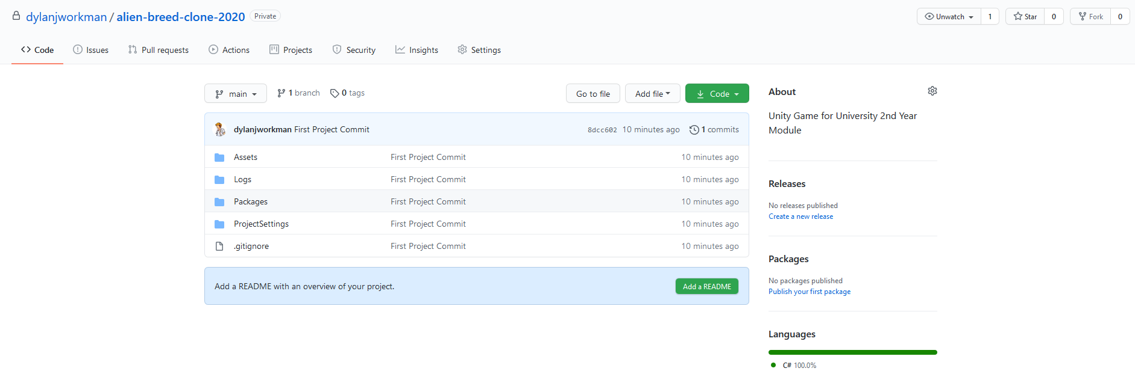
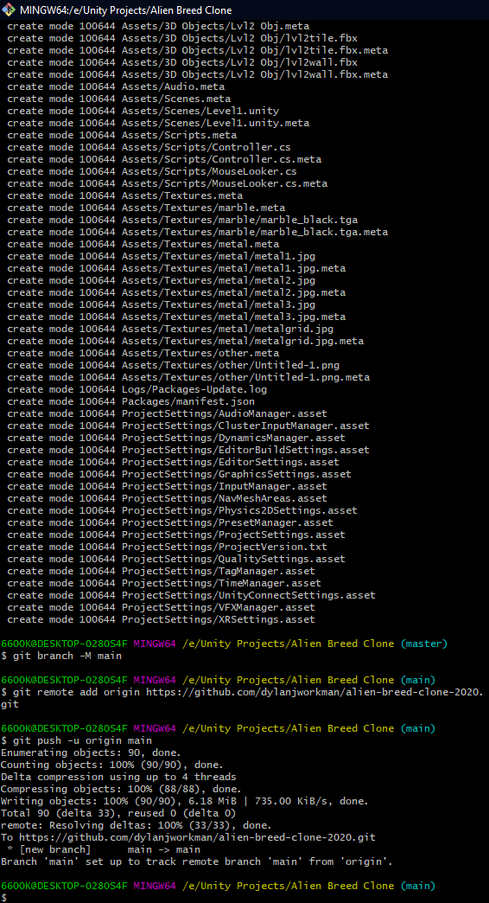
Unity Implementation: Version Control
Use of GitHub and or BitBucket for version control system
Useful for preserving code and cross-platform builds

Slide 17
Thanks for Listening and Watching!

